Slide 1

Operating Systems
ADITYA COLLEGE OF ENGINEERING &
TECHNOLOGY
Unit-3
Inter Process Communication

Slide 2
Contents
Aditya College of Engineering &
Technology
Process Synchronization
Producer-Consumer Problem Example
Race Condition
The Critical-Section Problem
Peterson’s Solution
Semaphores
Classical Problems of Synchronization
Bounded-Buffer Problem
Readers and Writers Problem
Dining-Philosophers Problem
Monitors
Synchronization Hardware

Slide 3
Process Synchronization
Aditya College of Engineering &
Technology
When two or more processes cooperates with each other, their order of execution must be preserved otherwise there can be conflicts in their execution and inappropriate outputs can be produced.
A cooperative process is the one which can affect the execution of other process or can be affected by the execution of other process.
Such processes need to be synchronized so that their order of execution can be guaranteed.
The procedure involved in preserving the appropriate order of execution of cooperative processes is known as Process Synchronization.
Process Synchronization means sharing system resources by processes in a such a way that, Concurrent access to shared data is handled thereby minimizing the chance of inconsistent data.
Maintaining data consistency demands mechanisms to ensure synchronized execution of cooperating processes.

Slide 4
Aditya College of Engineering &
Technology
Producer-Consumer Problem
Bounded-Buffer
• Shared data
#define BUFFER_SIZE 10
typedef struct
{
. . .
} item;
item buffer[BUFFER_SIZE];
int in = 0;
int out = 0;
int counter = 0;

Slide 5
Aditya College of Engineering &
Technology
Bounded-Buffer
• Producer process
item nextProduced;
while (1)
{
while (counter == BUFFER_SIZE)
; /* do nothing */
buffer[in] = nextProduced;
in = (in + 1) % BUFFER_SIZE;
counter++;
}

Slide 6
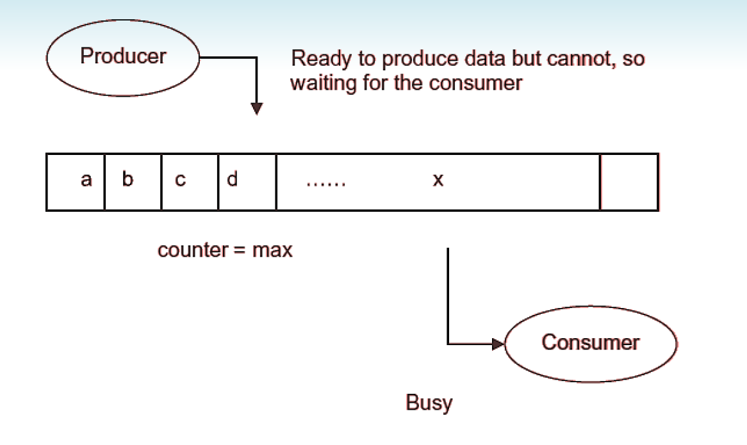
Producer-consumer problem: Buffer is full
Aditya College of Engineering &
Technology

Slide 7
Aditya College of Engineering &
Technology
Bounded-Buffer
• Consumer process
item nextConsumed;
while (1) {
while (counter == 0)
; /* do nothing */
nextConsumed = buffer[out];
out = (out + 1) % BUFFER_SIZE;
counter--;
}

Slide 8
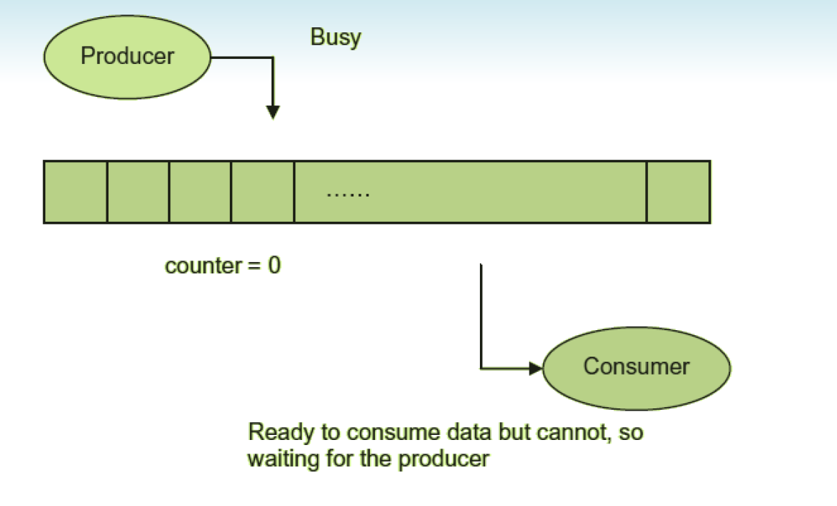
Producer-consumer problem: Buffer is empty
Aditya College of Engineering &
Technology

Slide 9
Bounded Buffer
Aditya College of Engineering &
Technology
The statements
counter++;
counter--;
must be performed atomically.
Atomic operation means an operation that completes in its entirety without interruption.

Slide 10
Bounded Buffer
Aditya College of Engineering &
Technology
The statement “counter++” may be implemented in machine language as:
register1 = counter
register1 = register1 + 1
counter = register1
The statement “counter--” may be implemented as:
register2 = counter
register2 = register2 – 1
counter = register2

Slide 11
Bounded Buffer
Aditya College of Engineering &
Technology
If both the producer and consumer attempt to update the buffer concurrently, the assembly language statements may get interleaved.
Interleaving depends upon how the producer and consumer processes are scheduled.
Assume counter is initially 5.
One interleaving of statements is:
producer: register1 = counter (register1 = 5)
producer: register1 = register1 + 1 (register1 = 6)
consumer: register2 = counter (register2 = 5)
consumer: register2 = register2 – 1 (register2 = 4)
producer: counter = register1 (counter = 6)
consumer: counter = register2 (counter = 4)
The value of counter may be either 4 or 6, where the correct result should be 5.

Slide 12
Aditya College of Engineering &
Technology
Race Condition
Race condition: The situation where several processes access – and manipulate shared data concurrently. The final value of the shared data depends upon which process finishes last.
To prevent race conditions, concurrent processes must be synchronized.

Slide 13
The Critical-Section Problem
Aditya College of Engineering &
Technology
Critical section problem is to design a protocol that the processes can use to cooperate.
Consider a system consists of n processes all competing to use some shared data.
Each process has a code segment, called critical section, in which the shared data is accessed.
One important feature of the system is that, when one process is executing in its critical section, no other process is allowed to execute in its critical section.
Each process must request permission to enter its critical section.
The section of code implementing this request is known as entry section.
The critical section may be followed by exit section.
The remaining code is in remainder section.

Slide 14
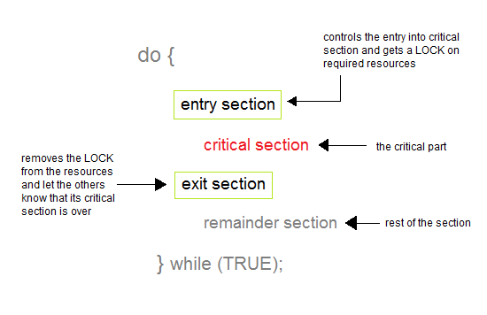
General structure of process p_{i}
Aditya College of Engineering &
Technology

Slide 15
Solution to Critical-Section Problem
Aditya College of Engineering &
Technology
Mutual Exclusion : If a process is executing in its critical section, then no other process is allowed to execute in their critical section.
Progress : If no process is executing in the critical section and other processes are waiting outside the critical section, then only those processes that are not executing in their remainder section can participate in deciding which will enter in the critical section next, and the selection can not be postponed indefinitely.
Bounded Waiting : A bound must exist on the number of times that other processes are allowed to enter their critical sections after a process has made a request to enter its critical section and before that request is granted.

Slide 16
Peterson’s Solution to critical Section Problem
Aditya College of Engineering &
Technology
Shared data:
int Process_turn;--------------mutual exclusion
boolean Process_flag[2];-----------------maintaining the state
Process p1
{
do
{
Process_flag[0]=true;
Process_turn=1;
While( process_flag[1] && process_turn==1)
; // do nothing
Critical section
Process_flag[0]=false;
}while(true);
Process p2
{
do
{
Process_flag[1]=true;
Process_turn=0;
While( process_flag[0] && process_turn==0 )
; // do nothing
Critical section
Process_flag[1]=false;
}while(true);

Slide 17
Disadvantages of Peterson’s Solution
Aditya College of Engineering &
Technology
It involves Busy waiting
It is limited to 2 processes.

Slide 18
Semaphores
Aditya College of Engineering &
Technology
Semaphore was proposed by Dijkstra in 1965 which is a very significant technique to manage concurrent processes by using a simple integer value, which is known as a semaphore.
Semaphore is simply a variable which is non-negative and shared between threads.
This variable is used to solve the critical section problem and to achieve process synchronization in the multiprocessing environment.
It is a process synchronization tool that does not require busy waiting.

Slide 19
Semaphore Implementation
Aditya College of Engineering &
Technology
It can only be accessed via two indivisible (atomic) operations (wait and signal).
wait (S):
P(S)
{
while (S<= 0)
; //no operation
S--;
}
signal (S):
V(S)
{
S++;
}

Slide 20
Aditya College of Engineering &
Technology
Types of Semaphores
Binary Semaphore( Resource with single instance) –
This is also known as mutex lock.
It can have only two values – 0 and 1.
Its value is initialized to 1.
It is used to implement the solution of critical section problem with multiple processes.
Counting Semaphore (Resource with multiple instances)–
Its value can range over an unrestricted domain.
It is used to control access to a resource that has multiple instances.

Slide 21
Critical Section of n Processes
Aditya College of Engineering &
Technology
Shared data:
semaphore mutex; //initially mutex = 1
Process Pi:
do
{
wait(mutex) ;
critical section
signal(mutex);
remainder section
} while (1);

Slide 22
Semaphore Implementation
Aditya College of Engineering &
Technology
Struct Semaphore
{
int sem_value;
queue sem_q;
};
Semaphore S;
Operation wait
P(S)
{
S.sem_value=S.sem_value-1
If(S.sem_value<0)
{
Add the Process to S.sem_queue;
Block the process;
}
}
Operation signal
V(S)
{
S.sem_value=S.sem_value+1;
If(S.Sem_value<=0)
{
Remove the Process from S.sem_queue;
Wakeup the process;
}
}

Slide 23
Classical Problems of Synchronization
Aditya College of Engineering &
Technology
Bounded-Buffer Problem(Producer-consumer Problem)
Readers and Writers Problem
Dining-Philosophers Problem

Slide 24
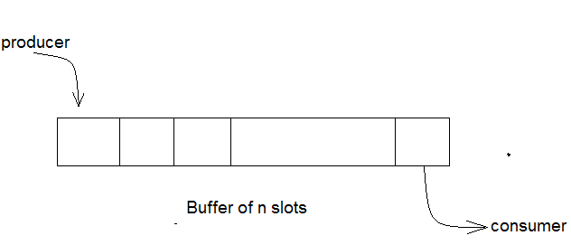
Bounded-Buffer Problem
Aditya College of Engineering &
Technology
Bounded buffer problem, which is also called producer consumer problem, is one of the classic problems of synchronization.
There is a buffer of n slots and each slot is capable of storing one unit of data.
There are two processes running, namely, producer and consumer, which are operating on the buffer.

Slide 25
Solution
Aditya College of Engineering &
Technology
A producer tries to insert data into an empty slot of the buffer. A consumer tries to remove data from a filled slot in the buffer.
One solution of this problem is to use semaphores.
The semaphores which will be used here are:
mutex, a binary semaphore which is used to acquire and release the lock.
empty, a counting semaphore whose initial value is the number of slots in the buffer, since, initially all slots are empty.
full, a counting semaphore whose initial value is 0.
Shared data
semaphore full, empty, mutex;
Initially:
full = 0, empty = n, mutex = 1

Slide 26
Bounded-Buffer Problem Producer Process
Aditya College of Engineering &
Technology
do {
…
produce an item in nextp
…
wait(empty)
; //wait on empty semaphore
wait(mutex)
; //wait on buffer access semaphore
…
add nextp to buffer
…
signal(mutex);
signal(full);
} while (1);

Slide 27
Producer Process
Aditya College of Engineering &
Technology
Looking at the above code for a producer, we can see that a producer first waits until there is atleast one empty slot.
Then it decrements the empty semaphore because, there will now be one less empty slot, since the producer is going to insert data in one of those slots.
Then, it acquires lock on the buffer, so that the consumer cannot access the buffer until producer completes its operation.
After performing the insert operation, the lock is released and the value of full is incremented because the producer has just filled a slot in the buffer.

Slide 28
Bounded-Buffer Problem Consumer Process
Aditya College of Engineering &
Technology
do {
wait(full); //wait on full semaphore
wait(mutex); //wait on buffer access semaphore
…
remove an item from buffer to nextc
…
signal(mutex);
signal(empty);
…
consume the item in nextc
…
} while (1);

Slide 29
Consumer Process
Aditya College of Engineering &
Technology
The consumer waits until there is atleast one full slot in the buffer.
Then it decrements the full semaphore because the number of occupied slots will be decreased by one, after the consumer completes its operation.
After that, the consumer acquires lock on the buffer.
Following that, the consumer completes the removal operation so that the data from one of the full slots is removed.
Then, the consumer releases the lock.
Finally, the empty semaphore is incremented by 1, because the consumer has just removed data from an occupied slot, thus making it empty.

Slide 30
Readers-Writers Problem
Aditya College of Engineering &
Technology
Readers writer problem is another example of a classic synchronization problem.
Problem Statement
There is a shared resource which should be accessed by multiple processes.
There are two types of processes in this context. They are reader and writer.
Any number of readers can read from the shared resource simultaneously, but only one writer can write to the shared resource.
When a writer is writing data to the resource, no other process can access the resource.
A writer cannot write to the resource if there are non zero number of readers accessing the resource at that time.

Slide 31
Readers-Writers Problem Solution
Aditya College of Engineering &
Technology
From the above problem statement, it is evident that readers have higher priority than writer.
If a writer wants to write to the resource, it must wait until there are no readers currently accessing that resource.
Shared data
semaphore mutex, wrt;
Initially
mutex = 1, wrt = 1, readcount = 0

Slide 32
Writer Process
Aditya College of Engineering &
Technology
do
{
wait(wrt); 0
…
writing is performed
…
signal(wrt);
}while(TRUE);

Slide 33
Reader Process
Aditya College of Engineering &
Technology
do
{
wait(mutex);
readcount++;
if (readcount == 1)
wait(wrt);
signal(mutex);
…
reading is performed
…
wait(mutex);
readcount--;
if (readcount == 0)
signal(wrt);
signal(mutex);
}while(TRUE);

Slide 34
Dining Philosophers Problem
Aditya College of Engineering &
Technology
The dining philosophers problem is another classic synchronization problem which is used to evaluate situations where there is a need of allocating multiple resources to multiple processes.
Problem Statement:
Consider there are five philosophers sitting around a circular dining table.
The dining table has five chopsticks and a bowl of rice in the middle as shown in the below figure.

Slide 35
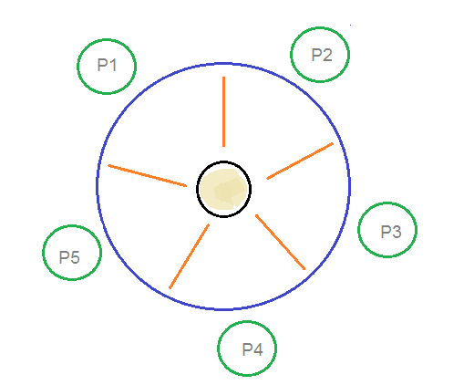
Dining Philosophers Problem
Aditya College of Engineering &
Technology
2
3
1
4
5
At any instant, a philosopher is either eating or thinking.
When a philosopher wants to eat, he uses two chopsticks - one from their left and one from their right.
When a philosopher wants to think, he keeps down both chopsticks at their original place.

Slide 36
Solution
Aditya College of Engineering &
Technology
From the problem statement, it is clear that a philosopher can think for an indefinite amount of time. But when a philosopher starts eating, he has to stop at some point of time. The philosopher is in an endless cycle of thinking and eating.
An array of five semaphores, stick[5], for each of the five chopsticks.
The code for each philosopher looks like:
while(TRUE)
{
wait(stick[i]) ;
/* mod is used because if i=5, next
chopstick is 1 (dining table is circular) */
wait(stick[(i+1) % 5]);
/* eat */
signal(stick[i]);
signal(stick[(i+1) % 5]);
/* think */
}

Slide 37
Aditya College of Engineering &
Technology
When a philosopher wants to eat the rice, he will wait for the chopstick at his left and picks up that chopstick. Then he waits for the right chopstick to be available, and then picks it too. After eating, he puts both the chopsticks down.
But if all five philosophers are hungry simultaneously, and each of them pickup one chopstick, then a deadlock situation occurs because they will be waiting for another chopstick forever.
The possible solutions for this are:
A philosopher must be allowed to pick up the chopsticks only if both the left and right chopsticks are available.
Allow only four philosophers to sit at the table. That way, if all the four philosophers pick up four chopsticks, there will be one chopstick left on the table. So, one philosopher can start eating and eventually, two chopsticks will be available. In this way, deadlocks can be avoided.

Slide 38
Monitors
Aditya College of Engineering &
Technology
High-level synchronization construct that allows the safe sharing of an abstract data type among concurrent processes.
monitor monitor-name
{
shared variable declarations
procedure body P1 (…) {
. . .
}
procedure body P2 (…) {
. . .
}
procedure body Pn (…) {
. . .
}
{
initialization code
}
}

Slide 39
Monitors
Aditya College of Engineering &
Technology
To allow a process to wait within the monitor, a condition variable must be declared, as
condition x, y;
Condition variable can only be used with the operations wait and signal.
The operation
x.wait();
means that the process invoking this operation is suspended until another process invokes
x.signal();
The x.signal operation resumes exactly one suspended process. If no process is suspended, then the signal operation has no effect.

Slide 40
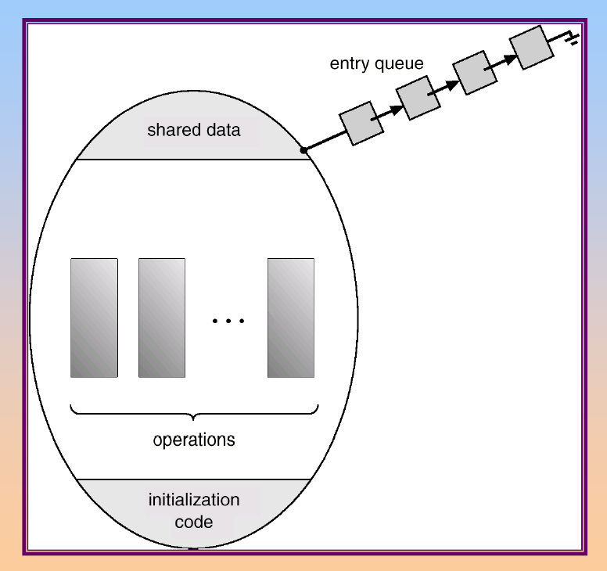
Schematic View of a Monitor
Aditya College of Engineering &
Technology

Slide 41
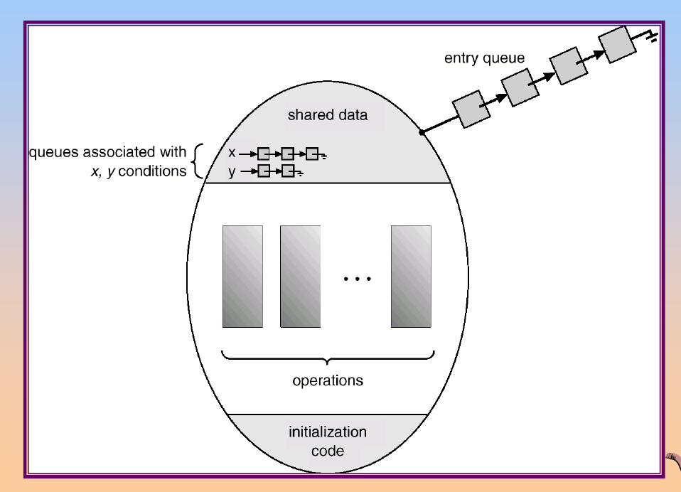
Monitor With Condition Variables
Aditya College of Engineering &
Technology

Slide 42
Monitors
Aditya College of Engineering &
Technology
Monitor is used to control access to state variables and condition variables. It only tells when to enter and exit the segment.
This solution imposes the restriction that a philosopher may pick up her chopsticks only if both of them are available.
To code this solution, we need to distinguish among three states in which we may find a philosopher.
For this purpose, we introduce the following data structure:
THINKING – When philosopher doesn’t want to gain access to either fork.
HUNGRY – When philosopher wants to enter the critical section.
EATING – When philosopher has got both the forks, i.e., he has entered the section.

Slide 43
Dining Philosophers Example
Aditya College of Engineering &
Technology
monitor dp
{
enum {thinking, hungry, eating} state[5];
condition self[5];
void pickup(int i); // following slides
void putdown(int i); // following slides
void test(int i); // following slides
void init()
{
for (int i = 0; i < 5; i++)
state[i] = thinking;
}
}

Slide 44
Dining Philosophers
Aditya College of Engineering &
Technology
void pickup(int i)
{
state[i] = hungry;
test(i);
if (state[i] != eating)
self[i].wait();
}
void putdown(int i)
{
state[i] = thinking;
// test left and right neighbours
test((i+4) % 5);
test((i+1) % 5);
}

Slide 45
Dining Philosophers
Aditya College of Engineering &
Technology
void test(int i)
{
if ( (state[(i + 4) % 5] != eating) && (state[i] == hungry) &&
(state[(i + 1) % 5] != eating))
{
state[i] = eating;
self[i].signal();
}
}
It is easy to show that this solution ensures that no two neighbour’s are eating simultaneously and that no deadlocks will occur.
We note, however, that it is possible for a philosopher to starve to death.

Slide 46
Synchronization Hardware
Aditya College of Engineering &
Technology
In Process Synchronization, Test and Set Lock (TSL) is a synchronization
mechanism that uses a test-and-set instruction to provide the
synchronization among the processes.
It ensures mutual exclusion and freedom from deadlock.
Test and modify the content of a word atomically .
boolean TestAndSet(boolean &target)
{
boolean rv = target;
target = true;
return rv;
}

Slide 47
Mutual Exclusion with Test-and-Set
Aditya College of Engineering &
Technology
Shared data:
boolean lock = false;
Process Pi
do {
while (TestAndSet(lock)) ;
critical section
lock = false;
remainder section
}

Slide 48
Synchronization Hardware
Aditya College of Engineering &
Technology
Atomically swap two variables.
void Swap(boolean &a, boolean &b)
{
boolean temp = a;
a = b;
b = temp;
}

Slide 49
Mutual Exclusion with Swap
Aditya College of Engineering &
Technology
Shared data (initialized to false):
boolean lock;
boolean waiting[n];
Process Pi
do
{
key = true;
while (key == true)
Swap(lock,key);
critical section
lock = false;
remainder section
}

Slide 50
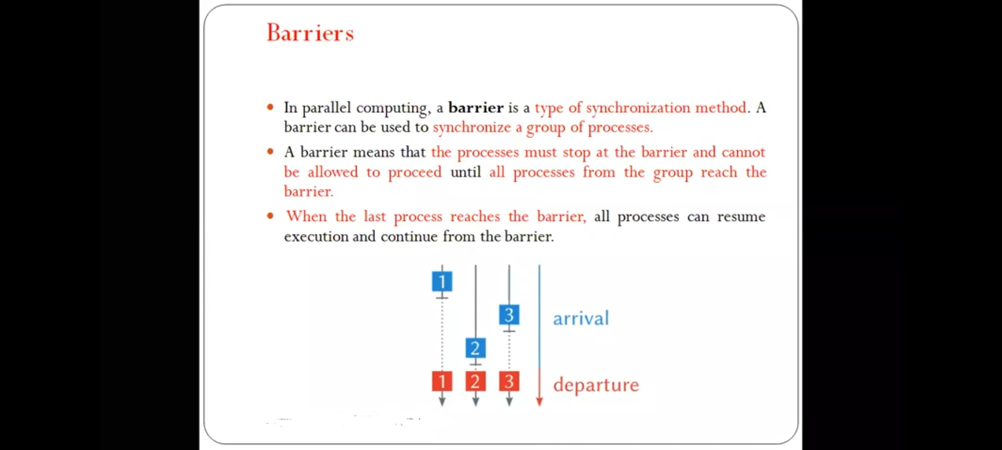

Slide 51
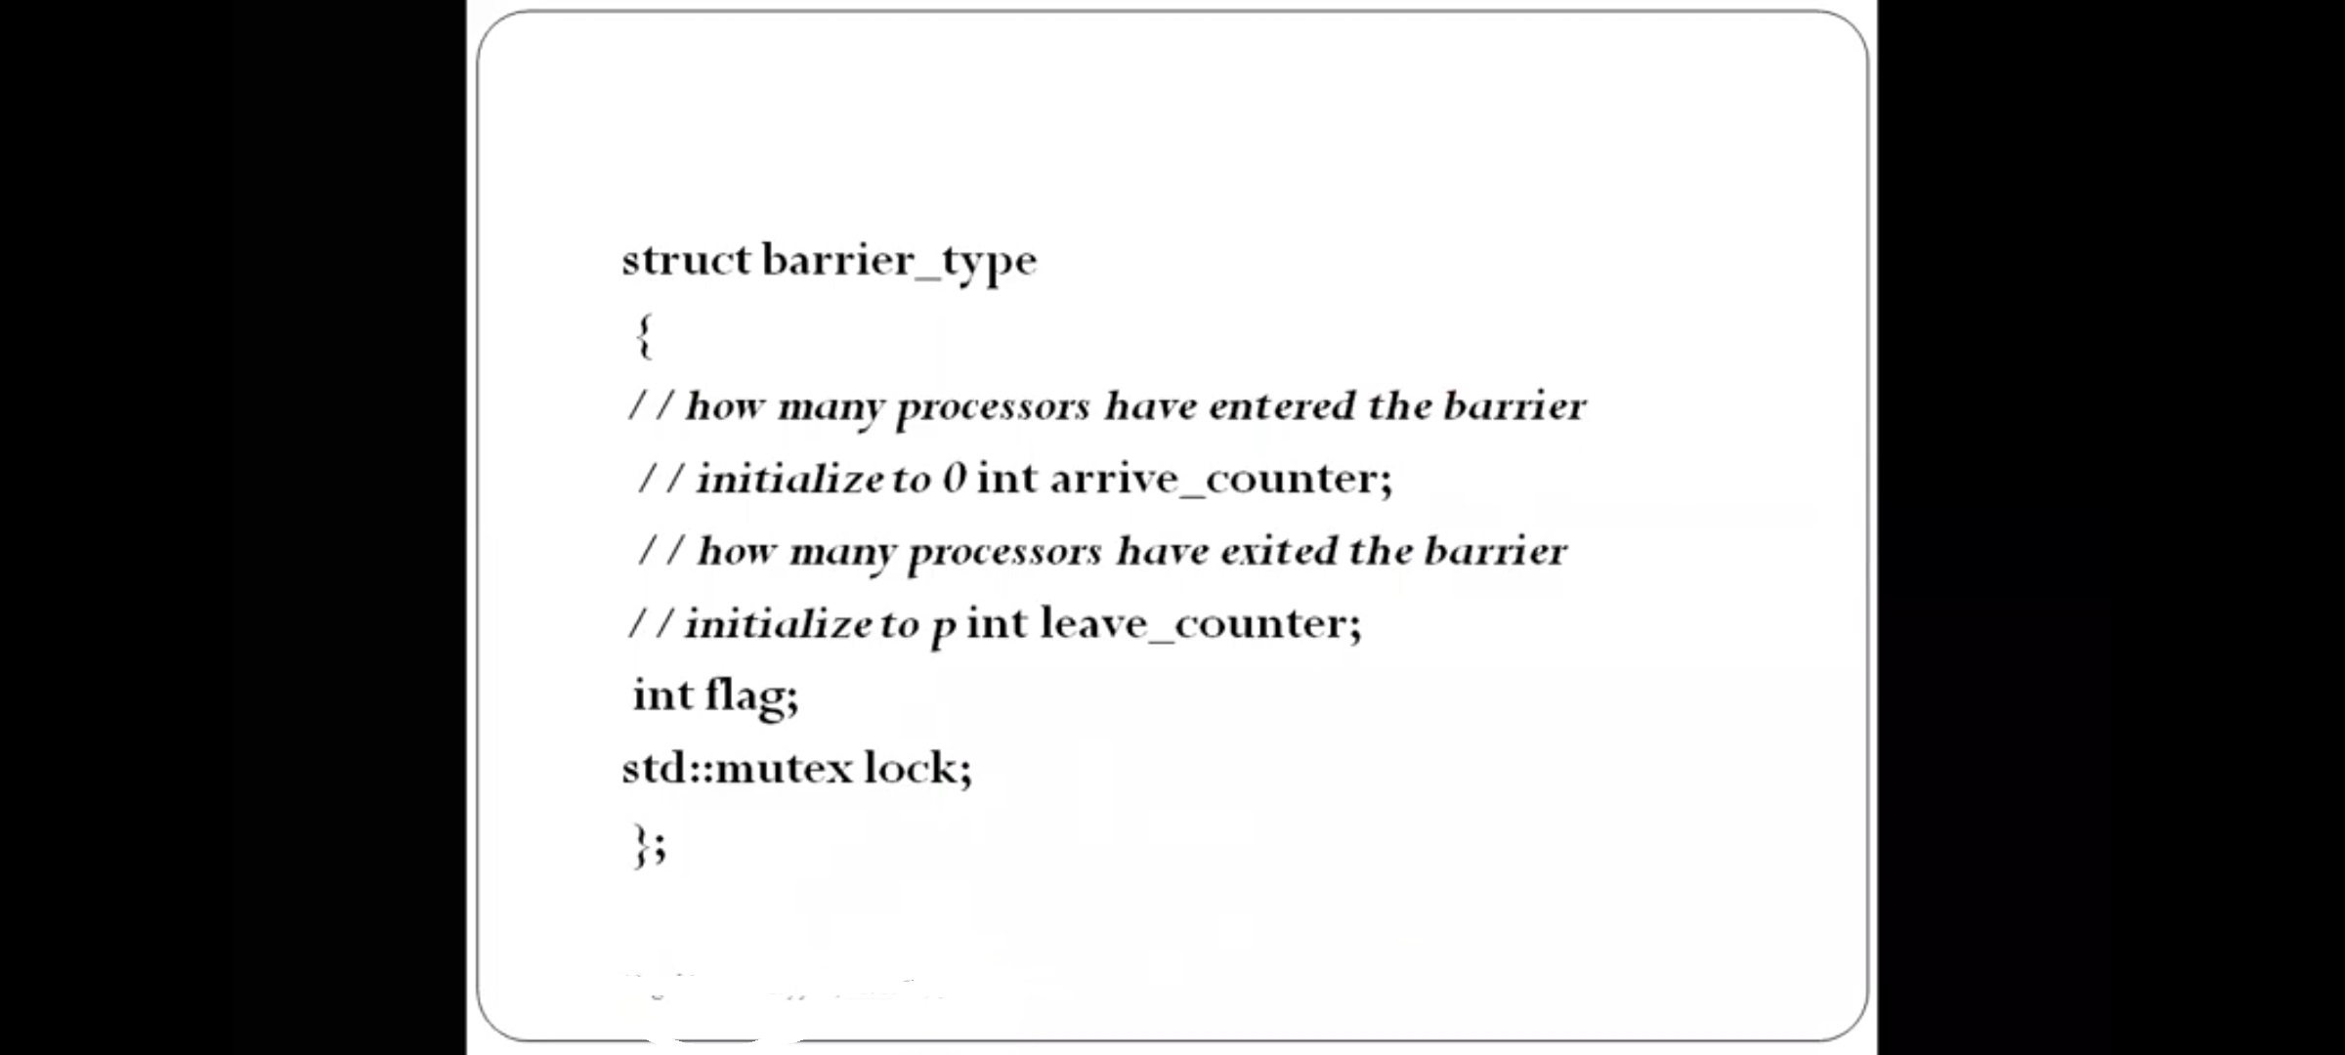

Slide 52
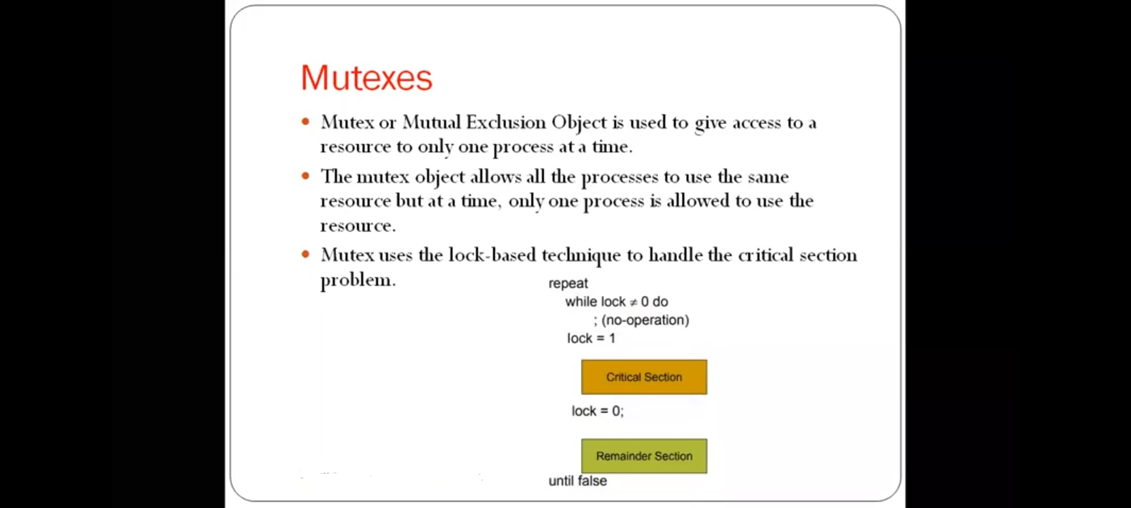

Slide 53
Aditya College of Engineering &
Technology
THANK YOU

